Slide 1
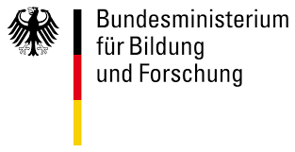

Computational Modeling of Metabolic Liver Function & Liver Function Tests
Matthias König
LiSyM Systems Medicine of the Liver
Humboldt University Berlin, Institute for Theoretical Biology

Slide 2
Why liver?
metabolism
Central organ of metabolism
Metabolic homeostasis (glucose, amino acids, …)
detoxification & clearance of compounds, xenobiotics & drugs
disease
~5 million affected by liver disease in Germany
Fatty liver (NAFLD/NASH), cirrhosis, hepatitis, alcoholic damage, cancer, …
Central role in metabolic diseases like diabetes & metabolic syndrom
system
Liver function is complex interplay of physiology, morphology, perfusion & metabolism on multiple scales

Slide 3
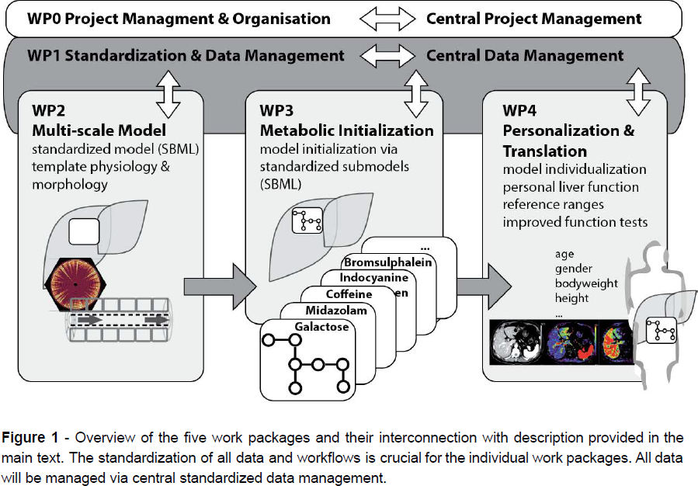
Junior Group LiSyM:
Multi-scale Modeling for Personalized Liver Function Tests

Slide 4
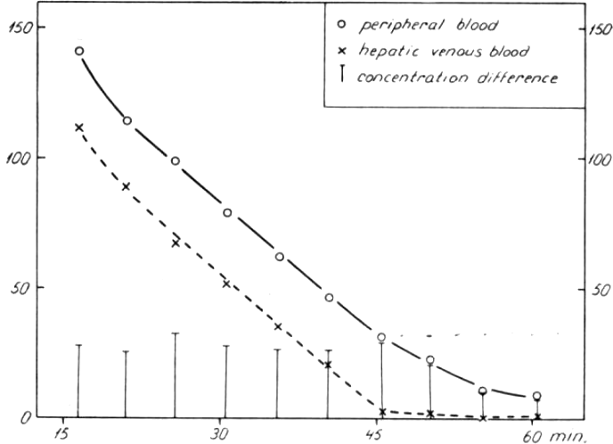
Liver function tests
Liver specific clearance of test substance
Non-invasive information
Rate of disappearance as proxy for function
Examples
Caffeine
Galactose elimination capacity (GEC)
Limax Test (Methacetin)
Importance
Liver transplantation (donor & recipient)
Liver resection (remaining capacity)
Diagnostics
Evaluation of interventions
Monitoring disease progression
galactose [mg %]
time [min]

Slide 5
Liver Function Tests
Analysis via simple cutoff
Don't account for large variability in liver volume, blood flow, organ volumes
Don't account for expression changes & pharmacogenomic variability
=> personalized physiological models (PKPD)
No liver specific information used for evaluation
morphology, perfusion, metabolism, ultrastructure
=> detailed kinetic multiscale models
galactose [mg %]
Vilstrup1974
time [min]

Slide 6
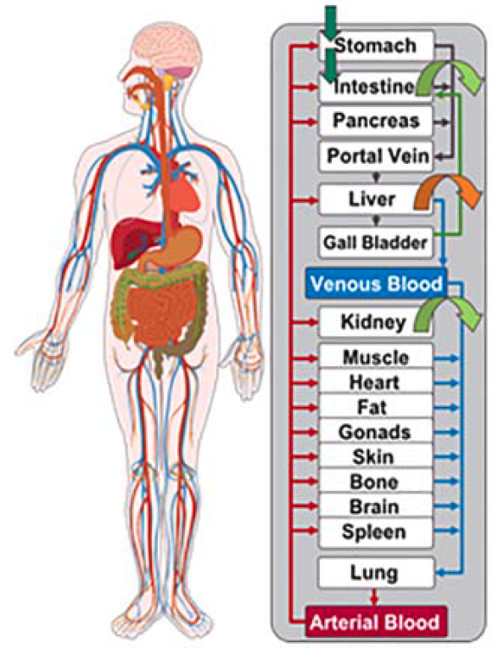
What are PKPD models?
PKPD
PharmacoKinetics: determines fate of substances administered to organism
PharmacoDynamics is the study of how the drug affects the organism
PKPD Models
human/animal physiology in the computer
combine information on the drug with knowledge on the physiology and biology at organism level
Specific models for certain drugs & substances
contain explicit representation of the organs most relevant for Absorption, Distribution, Metabolism, Elimination (ADME)
Tissues are linked by arterial and venous blood compartments characterized by associated blood flow rates, tissue-partition coefficient , and permeability
Kuepfer2016

Slide 7
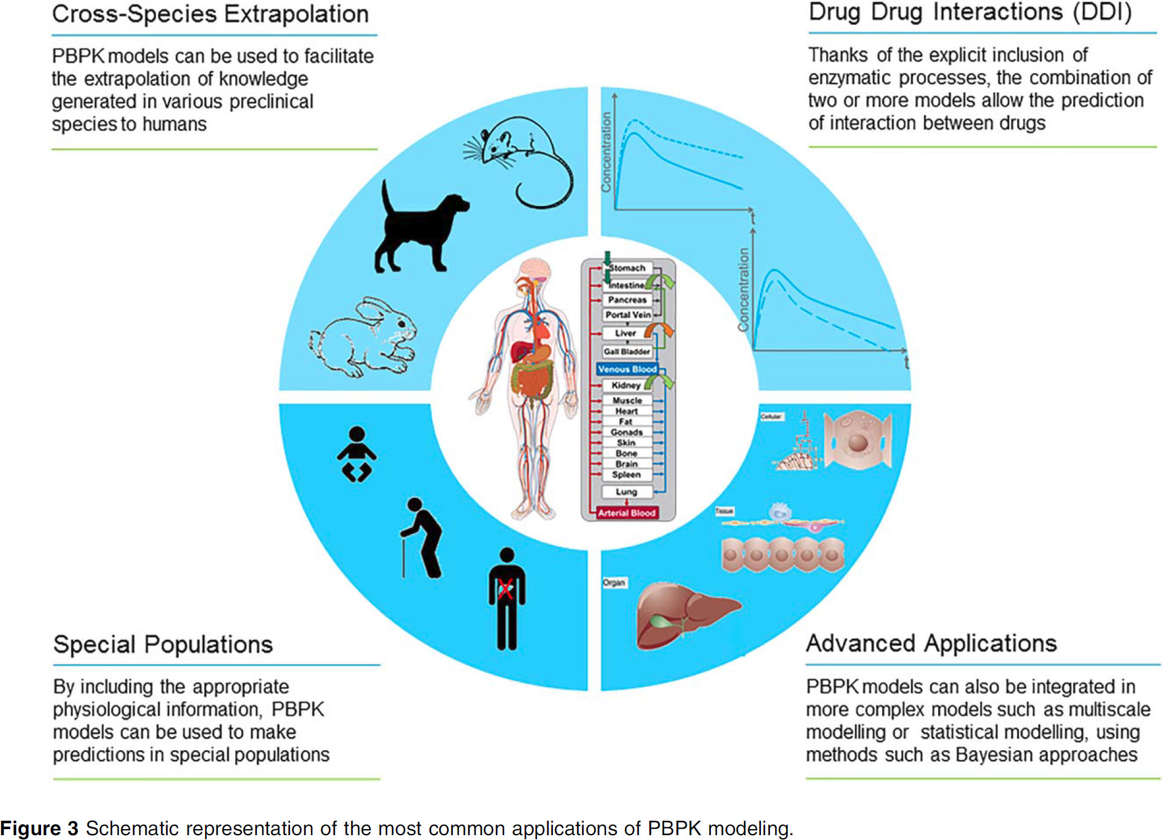
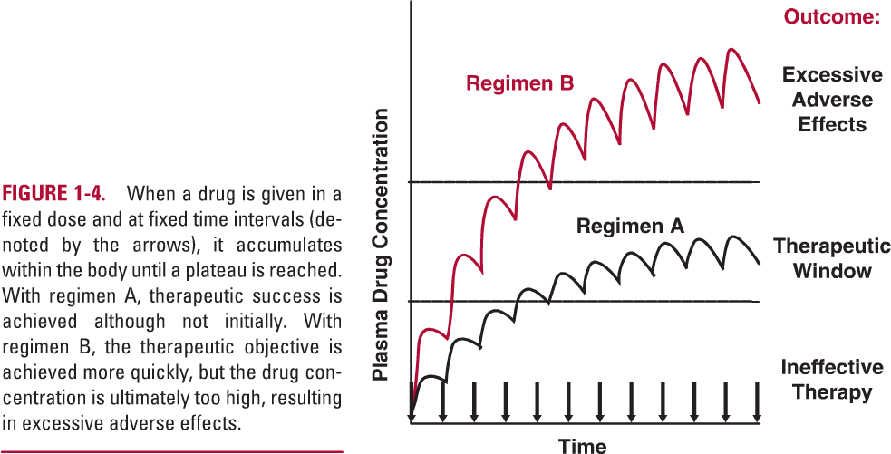
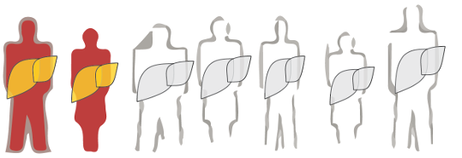
PKPD Applications
Individual Dosing
In silico drug trials
Kuepfer2016

Slide 8
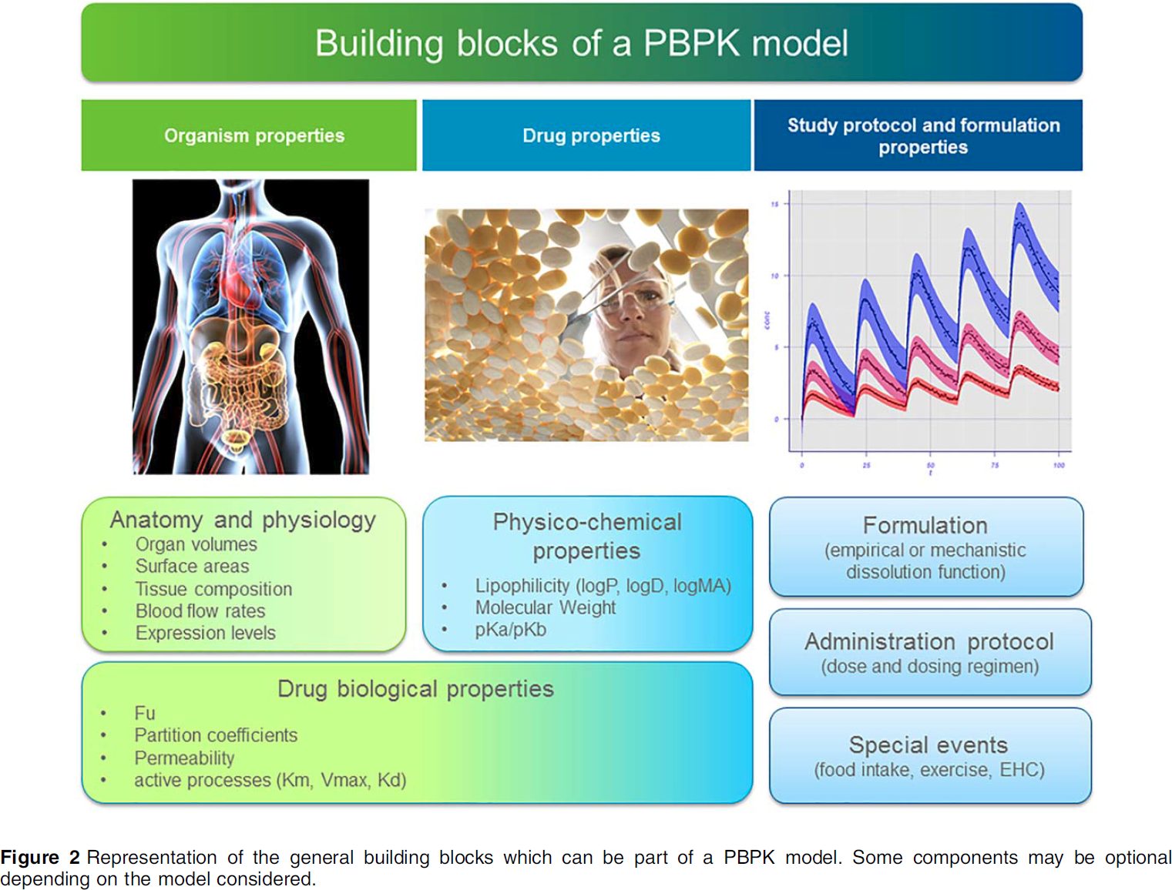
Kuepfer2016

Slide 9


Caffeine PKPD
Caffeine & smoking
M. König, manuscript in preparation

Slide 10

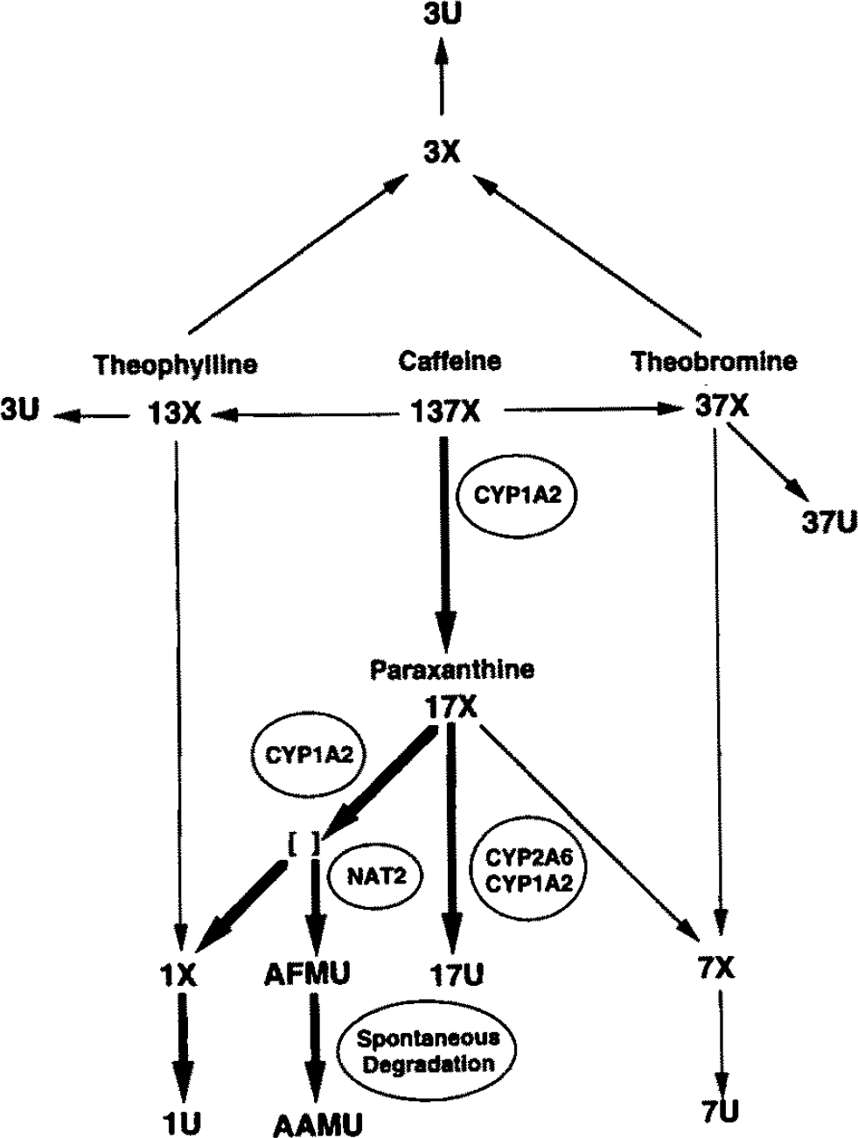
Caffeine (137X)
world's most widely consumed psychoactive drug
Metabolized in liver by CYP1A2
to paraxanthine (17X), theobromine & theophylline
Classical liver function test
Time course of caffeine
urinary ratios of methyl-xanthines
Caffeine/paraxanthine ratio
Large Variability
Effects of lifestyle on expression
Smoking is one of such lifestyle factors
Denaro1996
How is smoking affecting the clearance of caffeine ?
+
= ?

Slide 11
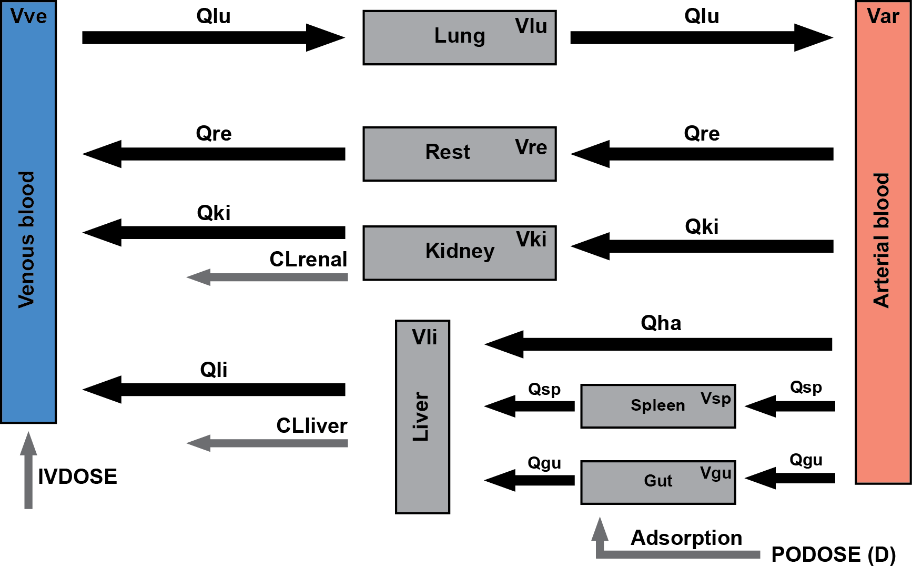

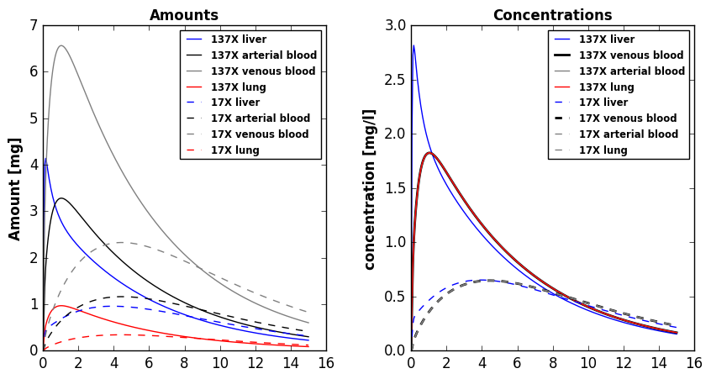
TODO: Illustrator (liver & human image)
TODO: better network image
PKPD
Kinetic model of caffeine liver metabolism
Renal clearance
Whole-body distribution kinetics
100 mg oral caffeine dose
Denaro1996

Slide 12
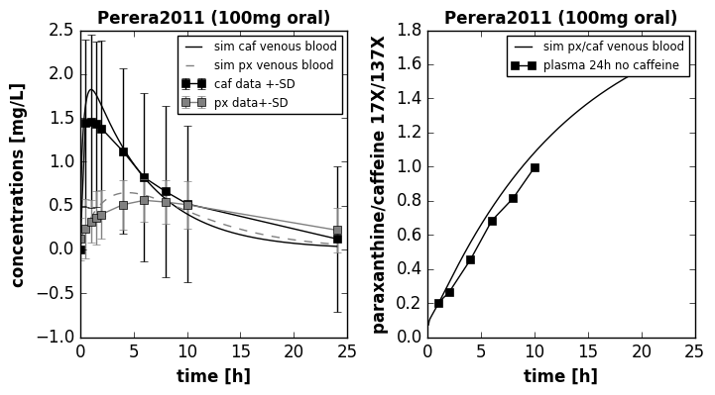
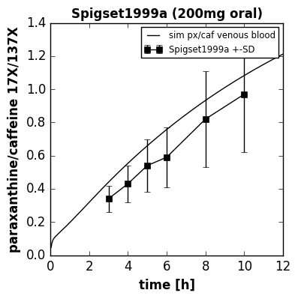
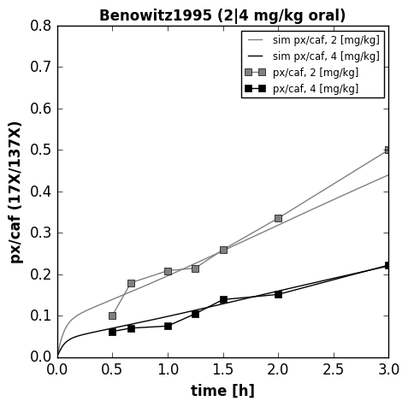
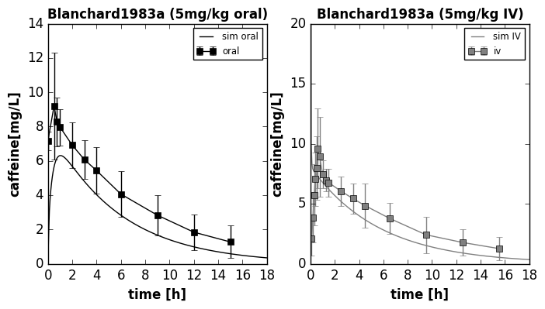
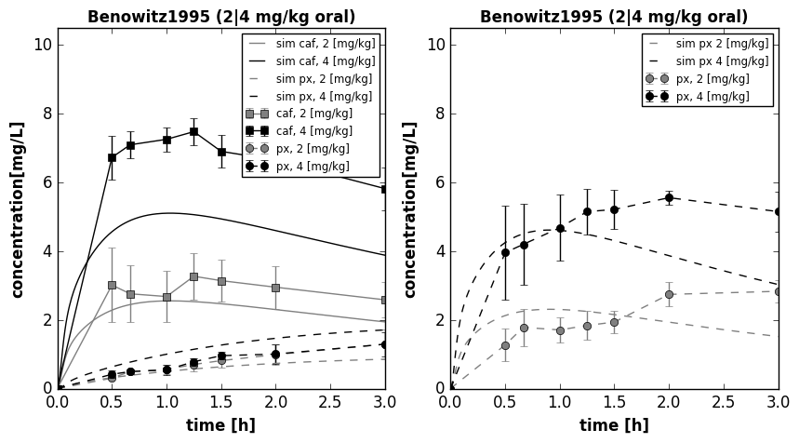
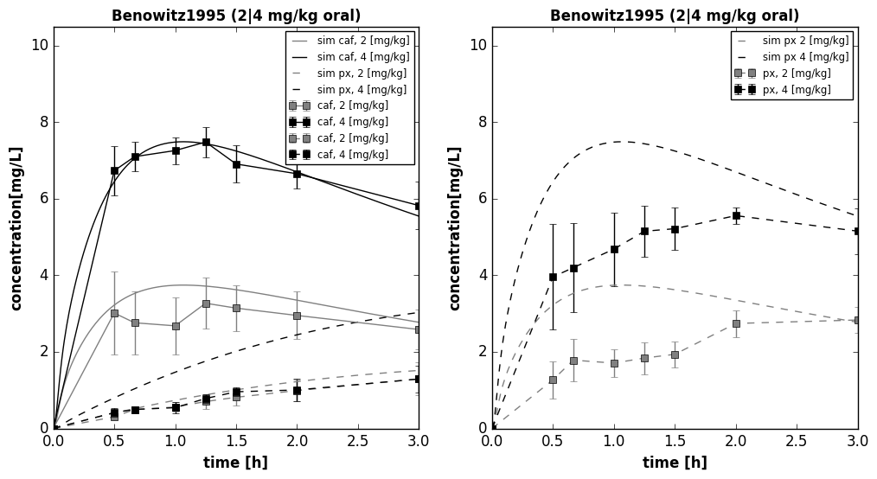
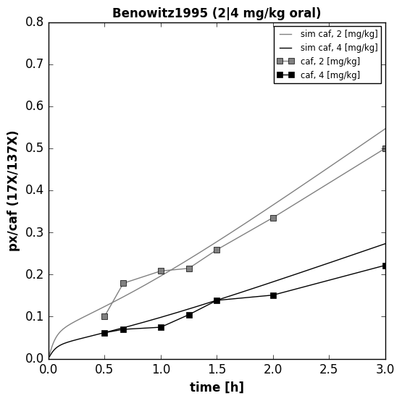
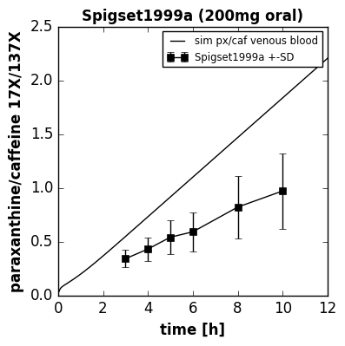
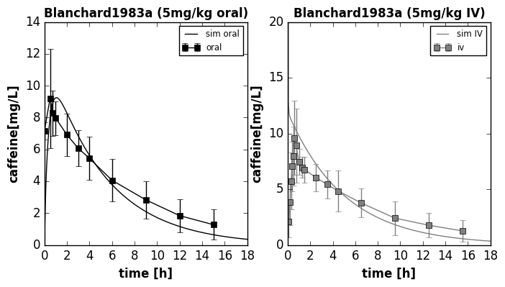

Mean model
human (70kg, male), mean microsomal CYP1A2 content, non-smoker
Model version 2

Slide 13
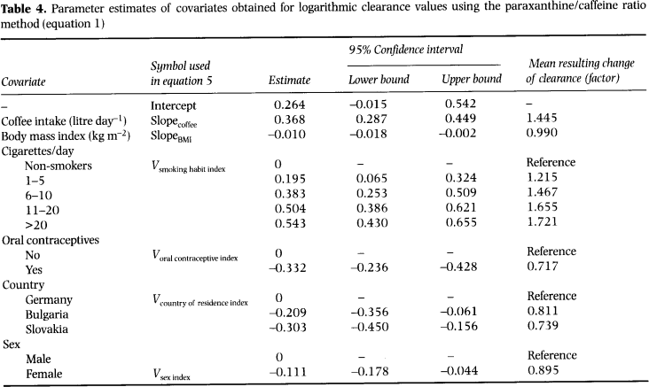
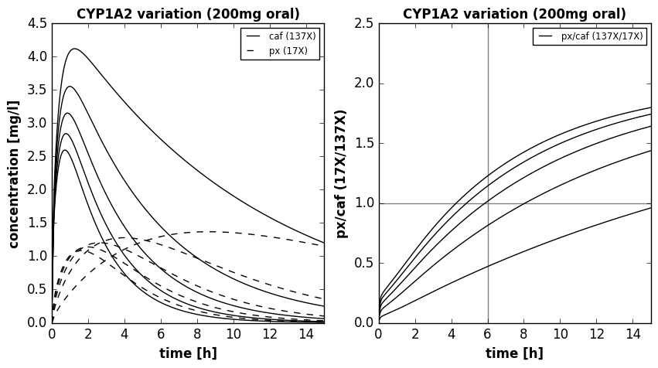
CYP1A2
CYP1A2 expression altered by many lifestyle factors
Strong effect: Smoking
Altered function test results
clearance, half-life, kel, max value, metabolic ratios
_{CYP1A2 ▲}
CYP1A2 induction ▲
Clearance ▲
kel ▲
T1/2 ▼
Tmax ▼
px(17X)/caf(137X) ▲
_{CYP1A2 ▲}

Slide 14
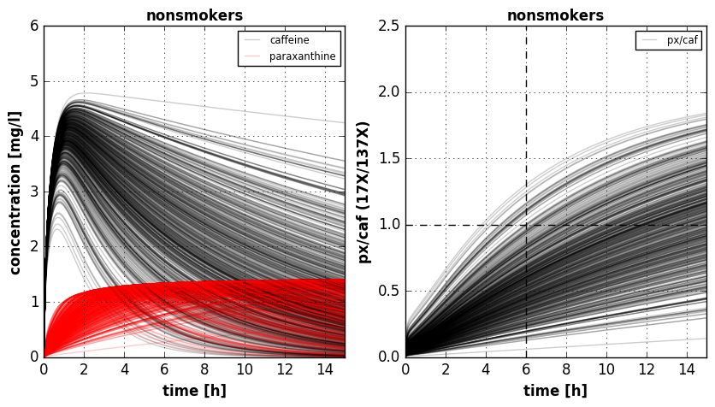

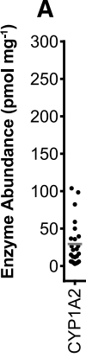
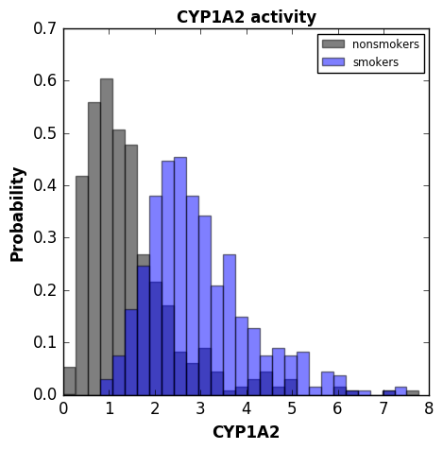
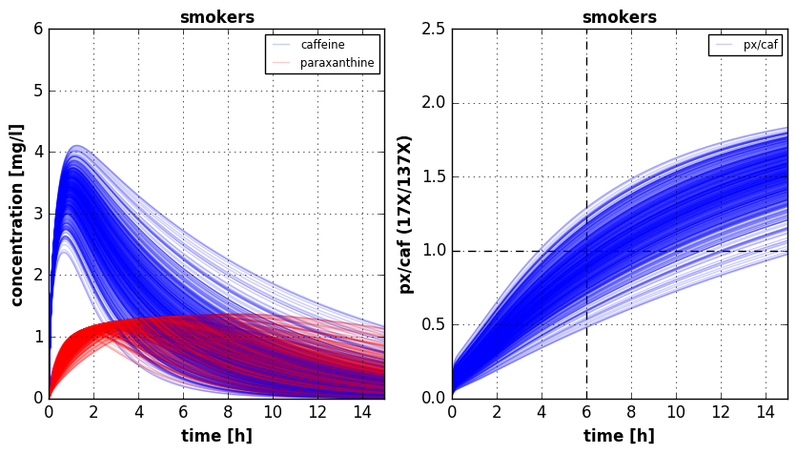

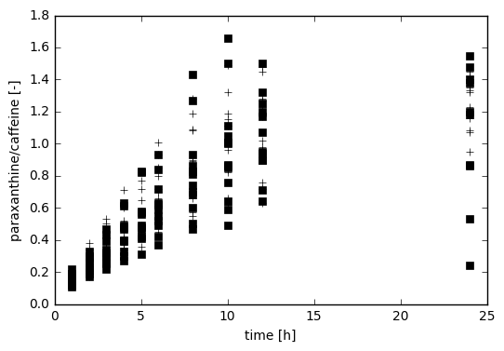
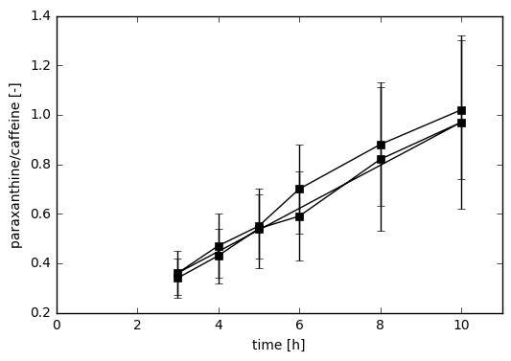
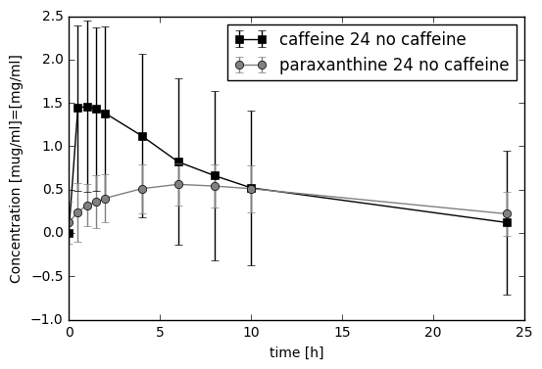
Smoking
CYP1A2 smoking effect
Distribution of liver microsome activity (log-normal) for non-smokers and smokers
Simulation of moderate smoking effect (6-10 cigerretes, ~40% increase)
TODO: print the mean curves with S.D in comparison
Data: Spigset1999a
Data: Spigset1999a
Data: Perera2011

Slide 15
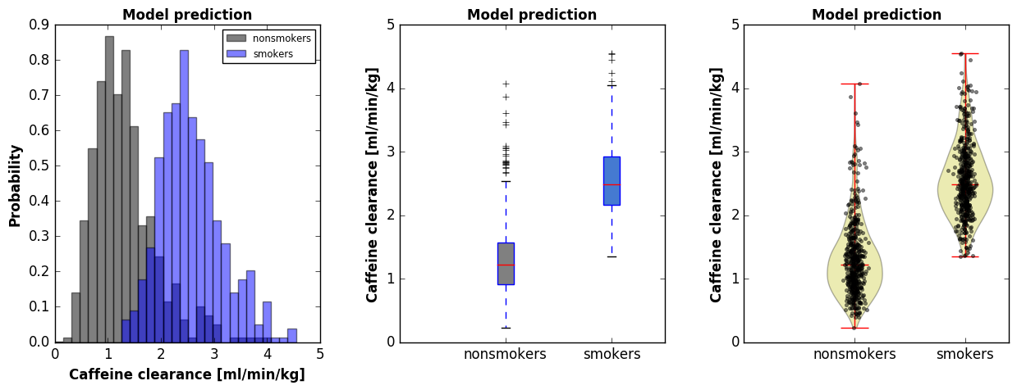
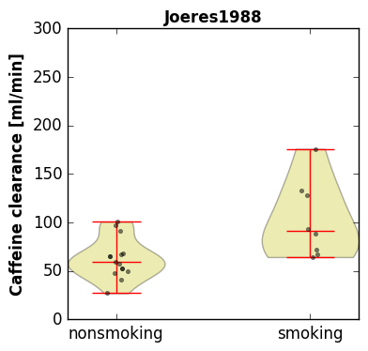
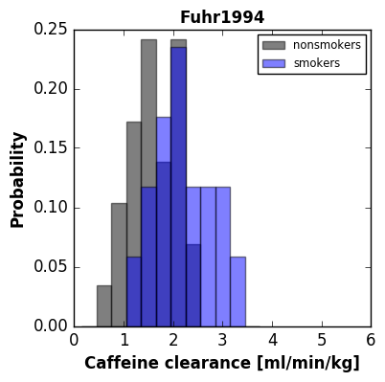
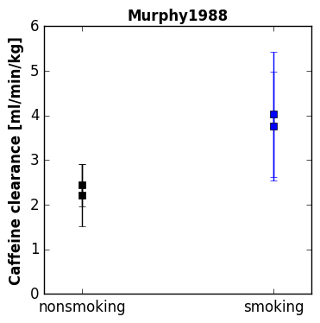
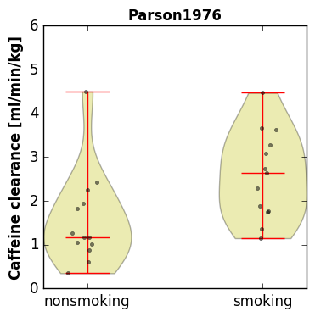
CL: Clearance

Slide 16
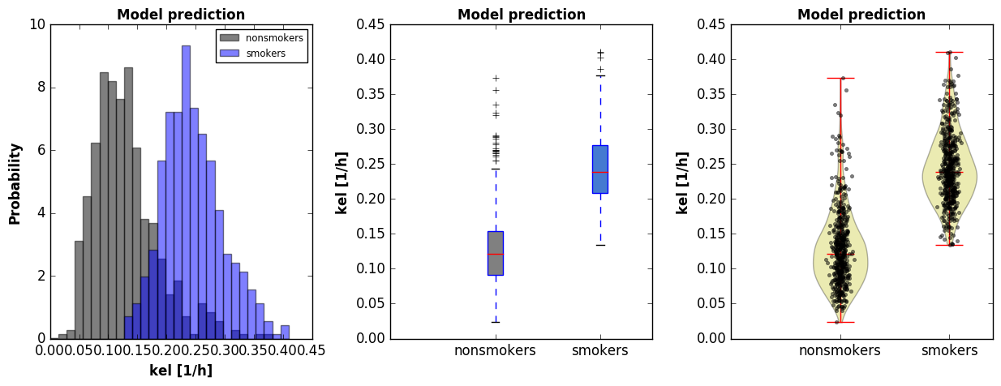
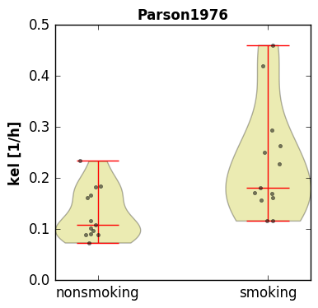
k_{el} : elimination rate

Slide 17
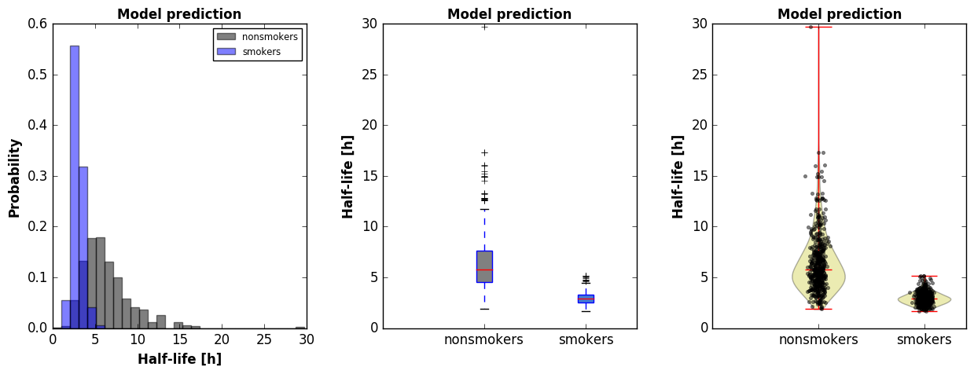
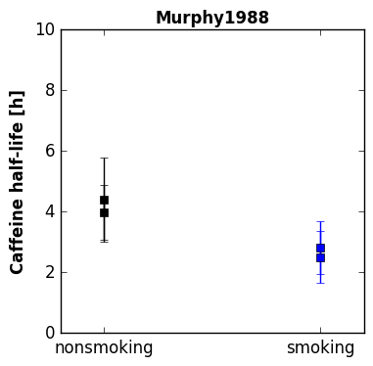
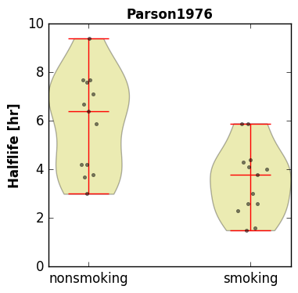
t_{1/2} : half-life

Slide 18
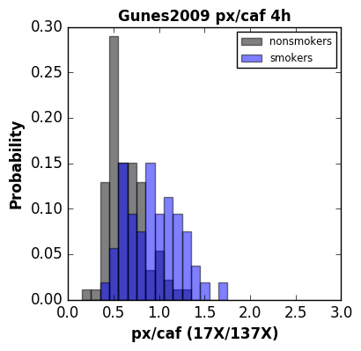
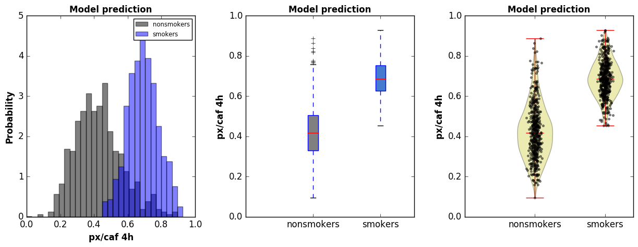
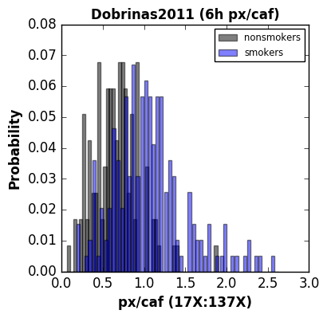
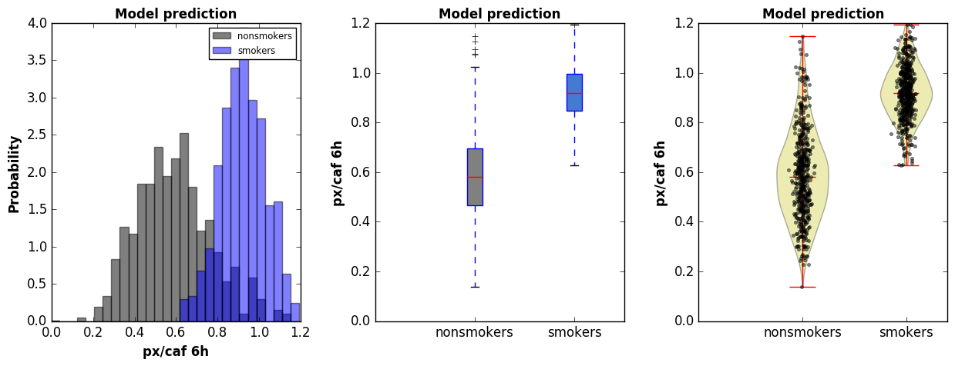
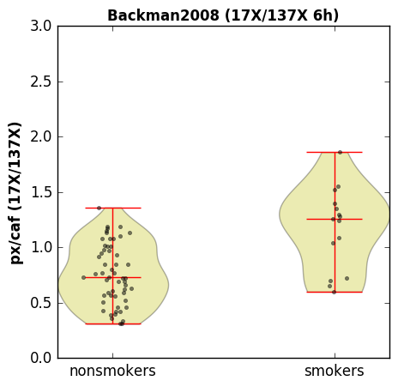
px/caf ratio (4h, 6h)

Slide 19
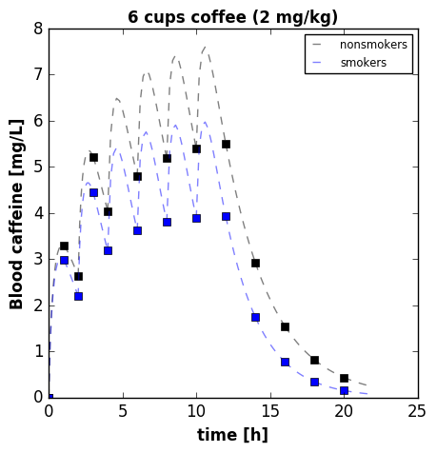
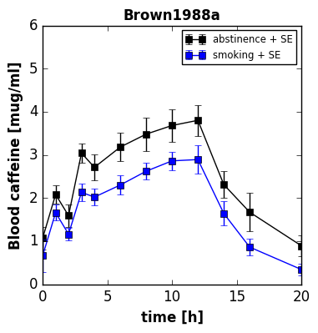
Coffee consumption
Multiple dosing
Adaption to smoking status, i.e. high smokers, via dose response curve (CYP1A2 ~ smoking)

Slide 20
Work in progress
Model improvement high caffeine doses & paraxanthine doses
Metabolism of additional methyl-xanthines describe urinary profile and change of urinary metabolite ratios with smoking (CYP1A2 activity)
Simulating Virtual Populations organ volume & blood flow scaling, adapting to respective study populations
Coupling to logistic regression model Smoking one example of CYP1A2 induction effect
Contraceptives, coffee consumption, genetic variants
Hybrid models
Validation with LiSyM drug cocktail
Existing dataset of individual subject caffeine time courses
Testing predictive performance of personalized simulations

Slide 21
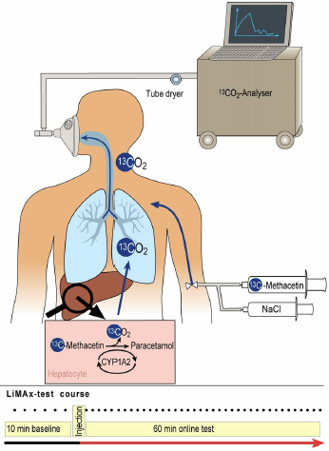
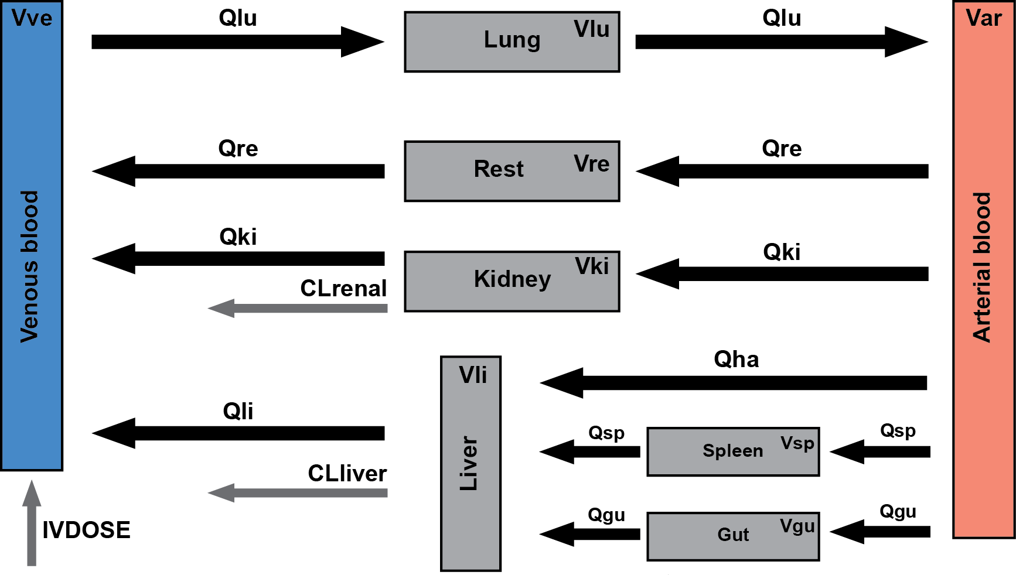
LiMAx
Applied Liver Function Test in Liver Transplantation & Resection
LiMAx PKPD model: methacetine, paracetamol, CO2
Model calibration
Existing timecourse data of methacetin, paracetamol, DOB & CO2 distribution kinetics
Analysis: Effect of smoking on LiMAx results & correction of test for smoking (contraceptives)
CYP1A2 substrate (analog changes like caffeine)
Model Validation: Retrospective analysis of large LiMAx data sets
Planned prospective study (grant application)
LiMAx & Smoking M.König, T. Wünsch & Prof. Stockmann

Slide 22
Galactose (GEC)
König, Marchesini, Bianchi, Holzhütter

Slide 23
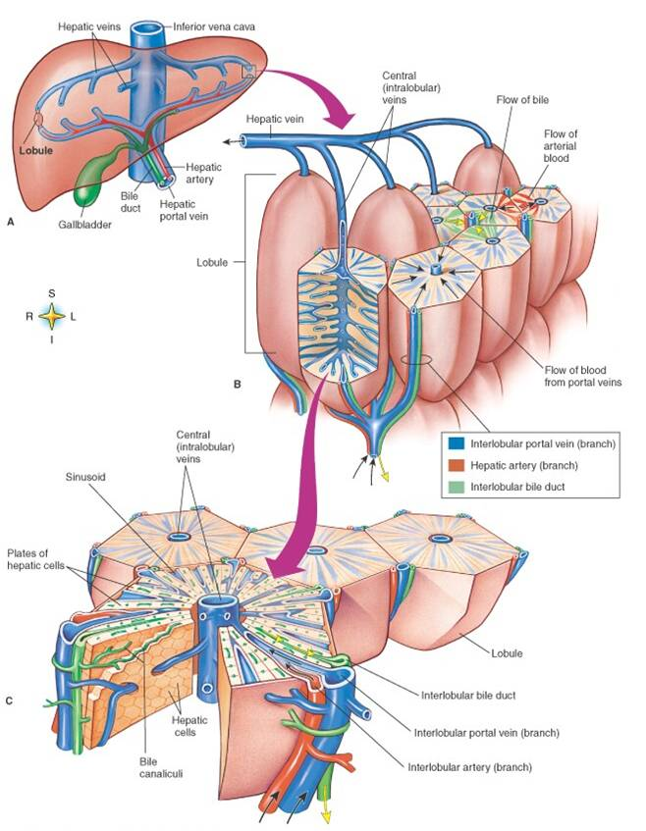
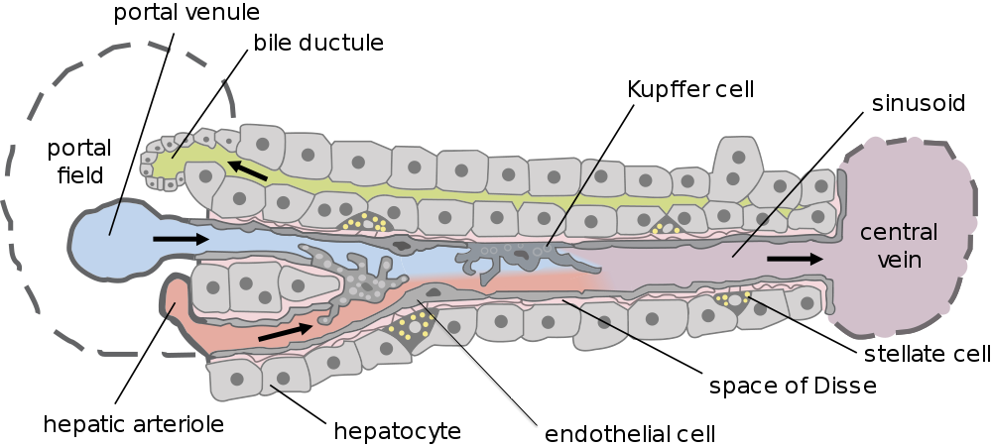
Liver architecture
Liver
Hierarchical architecture
Parallel circuit of hexagonal subunits (lobulus)
Lobulus consists of network of sinusoids
Hepatocytes main cell type
Dual blood supply
Portal vein (80%)
Hepatic artery (20%)
Lobulus
Sinusoidal unit
Hepatocyt

Slide 24

Galactose Elimination Capacity
König M., Marchesini G., Bianchi G. and Holzhütter HG.
A Multiscale Computational Model Predicts Human Liver Function From Single-Cell Metabolism
2017, [manuscript in preparation]

Slide 25
Multiple Indicator Dilution
Heterogeneity
Liver function depends strongly on local liver perfusion, ultrastructure & test substance
Input-Output profile after test substances

Slide 26
Liver Galactose elimination, extraction ratio & clearance
Galactose Elimination [mmol/min]
Galactose Elimination [mmol/min]
Extraction Ratio [-]
Extraction Ratio [-]
Blood flow (Q) [ml/min]
Galactose [mM]
Blood flow (Q) [ml/min]
Galactose [mM]
Clearance [ml/min]
Clearance [ml/min]
Perivenious galactose [mM]
Perivenious galactose [mM]
Blood flow (Q) [ml/min]
Galactose [mM]
Blood flow (Q) [ml/min]
Galactose [mM]

Slide 27
Spatial galactose elimination
ALP (arterial liver
perfusion)
PVP (portal-venous
perfusion)
HPI (hepatic perfusion
index)
Wang2013
Perfusion CTs
Galactose elimination depending on local liver perfusion
GE [µmol/min/ml(tissue)]
Galactose elimination (8mM galactose)

Slide 28


GE [µmol/min/ml(tissue)]
Galactose elimination depending on galactose

Slide 29


Ultrastructural changes in aging
Pseudocapillarization
Endothelial cells are thickened and defenestrated with old age
Cogger2003, Warren2005

Slide 30

Reduced Clearance in aging
Extraction Ratio [-]
Extraction Ratio [-]
Galactose Elimination [mmol/min]
Galactose Elimination [mmol/min]
Blood flow (Q) [ml/min]
Galactose [mM]
Blood flow (Q) [ml/min]
Galactose [mM]
Clearance [ml/min]
Clearance [ml/min]
Perivenious galactose [mM]
Perivenious galactose [mM]
Blood flow (Q) [ml/min]
Galactose [mM]
Blood flow (Q) [ml/min]
Galactose [mM]
Reduced Clearance & Extraction ratio under low concentrations (local effect)
In combination with reduced liver volume & perfusion in age can have drastic effects on drug/compound clearance

Slide 31



Personalized prediction
Individual evalutation of liver function test
Simulation of in silico population representative of the individual subject
Population prediction
GEC [mmol/min]
age [years]
Classification Cirrhosis

Slide 32
Outlook
Integration with PKPD models
time courses of whole-body distribution and urinary extraction
In silico trials & virtual populations
Large dataset of individual subject galactose time courses for analysis (Marchesini)
Cluster simulations
Integration CT data
Simulate spatial heterogeneity in liver function
Integration with perfusion CT, functional CT for (Keiding)
TODO: Cluster image

Slide 33
Related Projects

Slide 34

Metabolic Modeling Liver
Kinetic models (glucose & central metabolism, detoxification)
Flux Balance Analysis Genome-scale liver
Hybrid approaches
König M. and Holzhütter HG.
Homeostasis of blood glucose - Computer simulations of central liver functions.
systembiologie.de 2014; 8:p.53-57
König M. and Holzhütter HG.
Kinetic Modeling of Human Hepatic Glucose Metabolism in T2DM Predicts Higher Risk of Hypoglycemic Events in Rigorous Insulin Therapy
J Biol Chem. 2012
König M., Bulik S. and Holzhütter HG.
Quantifying the Contribution of the Liver to the Homeostasis of Plasma Glucose: A Detailed Kinetic Model of Hepatic Glucose Metabolism Integrated with the Hormonal Control by Insulin, Glucagon and Epinephrine
PLoS Comput Biol. 2012
Gille C, Bölling C, Hoppe A, Bulik S, Hoffmann S, Hübner K, Karlstädt A, Ganeshan R, König M, Rother K, Weidlich M, Behre J, Holzhütter HG. HepatoNet1: a comprehensive metabolic reconstruction of the human hepatocyte for the analysis of liver physiology. Mol Syst Biol., 6:411., 2010

Slide 35

Central Carbon Model
Kinetic model of central liver metabolism
Berndt N., Bulik S., Wallach I., König M., Stockmann M., Meierhofer D. and Holzhütter HG.
Computational Assessment of Liver Metabolism
[2017, submitted]

Slide 36


Bioinformatics Analyses
https://www.ncbi.nlm.nih.gov/pmc/articles/PMC4654904/bin/12918_2015_229_Fig8_HTML.jpg
Abshagen*, König*, Hoppe A., Thomas M., Müller I., Ebert M., Weng H., Holzhütter HG., Zanger UM., Bode J., Vollmar B. and Dooley S.
* equal contribution
Pathobiochemical signatures of cholestatic liver disease in bile duct ligated mice 2015, BMC Systems Biology https://github.com/matthiaskoenig/bdl-analysis
Circadian omics data & Integration metabolic models
Patrick Pett, Hanspeter Herzel, Matthias König
Circadian rhythms in the mouse liver

Slide 37

Visualization & Data Integration
König
cy3sabiork: A Cytoscape app for visualizing kinetic data from SABIO-RK 2016 [version 1; referees: 2 approved with reservations]
http://f1000research.com/articles/5-1736/v1
https://github.com/matthiaskoenig/cy3sabiork
König, Rodriquez, and Dräger
cy3sbml: A Cytoscape app for SBML
2017, manuscript in preparation
https://github.com/matthiaskoenig/cy3sbml

Slide 38

Computational Tools
High performance simulators based on SBML
Python based modeling environment
Choi K., Medley JK., Cannistra C., König M., Smith L., Stocking K., and Sauro HM. Tellurium: A Python Based Integrated Environment for Biological Modeling and Simulation [2016, in revision]
Somogyi, Bouteiller, Glazier, König, Medley, Swat, Sauro.
libRoadRunner: a high performance SBML simulation and analysis library.
Bioinformatics. 2015
https://github.com/sys-bio/roadrunner

Slide 39

Standardization
Reproducible Computational Research
Application of standard formats
Integration of clinical/patient data with computational models
König M.*, Oellrich A.*, Waltemath D.*, Dobson R., Hubbard T., and Wolkenhauer O. * equal contribution Challenges and opportunities for system biology standards and tools in medical research [2016, accepted]
Wholecell Consortium (König M.) Toward community standards and software for whole-cell modeling IEEE Trans Biomed Eng. 2016 Jun 10.

Slide 40




Acknowledgement
Dr. Margarete Fischer-Bosch Institute of Clinical Pharmacology Stuttgart
Dr. Hofmann & Prof. Schwab
Metabolomics, clinical studies drug cocktails
Universitätsklinikum Jena, Experimentelle Transplantationschirurgie
Prof. Dahmen
Experimental mouse models, perfusion measurements, imaging
Charite Berlin
Prof. Stockmann & Dr. Tilo Wünsch
Limax Test (Liver function based on Methacetin clearance)
Prof. Holzhütter
Department of Internal Medicine & Gastroenterology, Aging and Nephrological Diseases, University of Bologna
Prof. Marchesini & Prof. Gianchi
Galactose Elimination Capacity (GEC), clinical studies
LiSyM & VLN

Slide 42


Application to Steatosis
Nalbantoglu2014
Simulation of altered function due to morphological & perfusion changes in Steatosis
Basic metabolic capacity
Local heterogeneity in fat storage (periportal & perivenious, liver regions)
Metabolic model of fat storage & release
Feedback of fat content on ultrastructure
Ballooning of cells, change in sinusoidal diameter
Grant application

Slide 43



Large individual variability

Slide 44



Variability Liver Enzymes
Cytochrome P450 system is the major durg-metabolizing enzyme system & is involved in the metabolism of numerous endogenous compounds and xenobiotics.
Archour2014b

Slide 45



Pharmacogenomics

Slide 46



Smoking cessation

Slide 47


Slide 48


WP0 Central Data Management
https://www.fairdomhub.org/projects/46
Project & assets are managed in central data management (SEEK & fairdomhub)
Multiple meetings/TC with data management (Heidelberg, Fairdom user meeting)
Project Webpage setup
Open Access (Models) & Open Source (Code) & Open Data (?)
https://www.livermetabolism.com/

Slide 49


Time table PLF

Slide 50
ADME
Absorption, Distribution, Metabolism, Elimination
Rowland2011

Slide 51
Every substance is different (ADME), physiology stays the same
Kuepfer2016
Rowland2011

Slide 52
ODE systems (differential equations)
Compartments: organs
State variables: drug & metabolite amounts
Rate rules
Blood flows, Transport, Disposition
Metabolism, Elimination
Absorption
Parameters:
Tissue partition coefficients
Protein binding
Kinetic parameter (transport & elimination)
Blood flows, organ volumes, …
Result: Time dependent concentrations of substances/drugs in organs, blood & urin
High pharmacological relevance since it enables the estimation of drug exposure not only in plasma but also at the site of action
Rowland2011

Slide 53
Analysis
C_{max} : Maximal concentration
T_{max} : time of maximal concentration
AUC : area under the curve
k_{el}: elimination rate fitting linear part of terminal phase (log)
t_{1/2} : half-life (= ln2/k_{el}) time for concentration to fall to half
Vd: volume of distribution (= CL/k), dilution space
CL: clearance (=Dose/AUC, =Dose/C(0)_{extrapolated})
Rowland2011

Slide 54


Model Standards
SBML: Systems Biology Markup Language
Standard machine-readable format for model exchange
Reproducibility & Exchange of models
Re-usability
Annotations (Semantic information)
Tool support
Simulators: COPASI, roadrunner
Model databases
Visualization
Analysis
...

